Slide 1
About lab this afternoon
https://docs.google.com/document/d/1cSCJ-Rc8t0Av4jr4a6SVClcLqz_yYyKJf9ia8s-u2hs/edit

Slide 2
Structural Formulas of Nitrogen-containing molecules
H₄N₂
H₂N₂
N₂

Slide 3
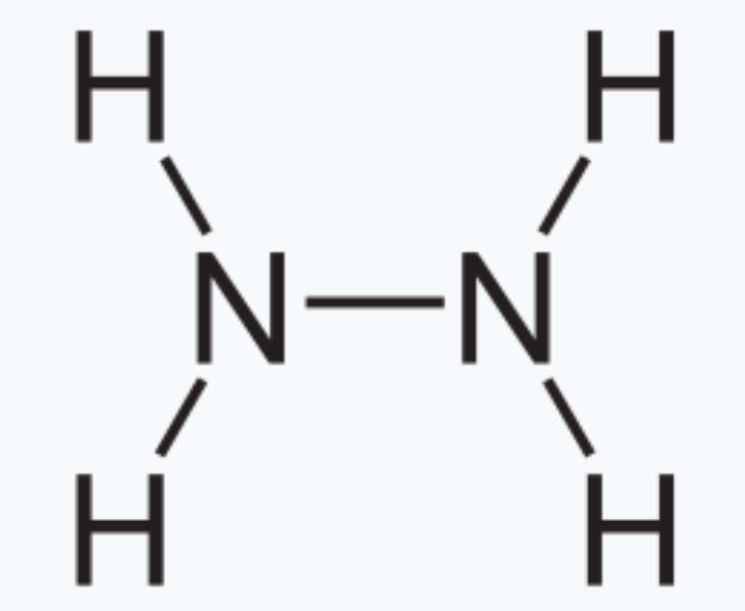
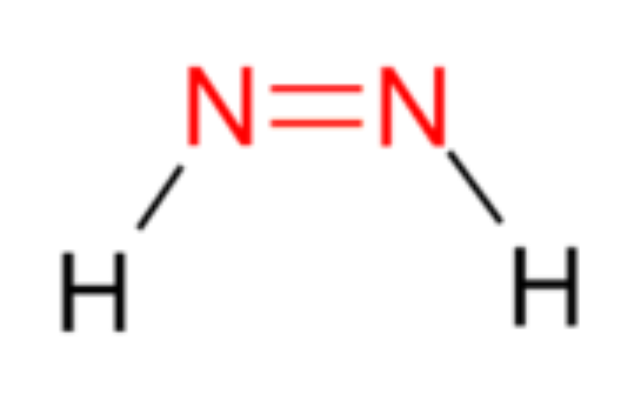

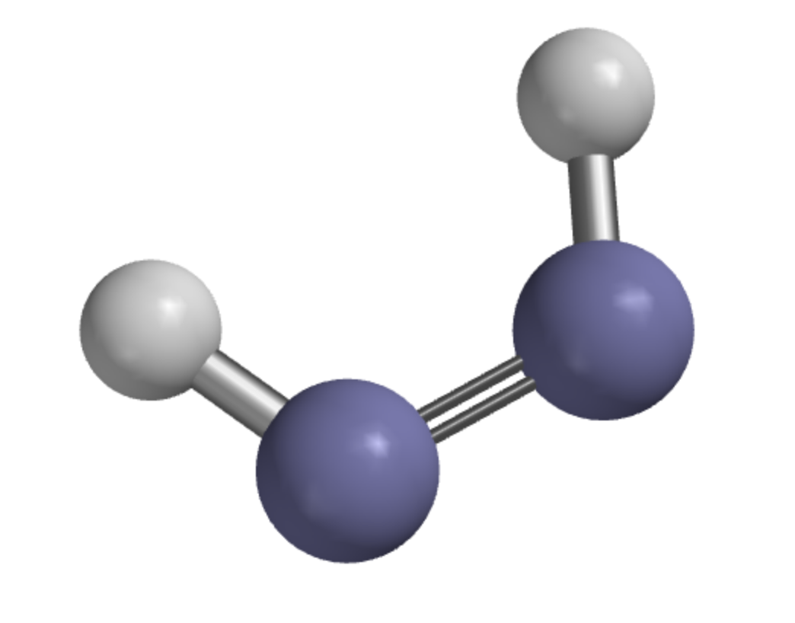
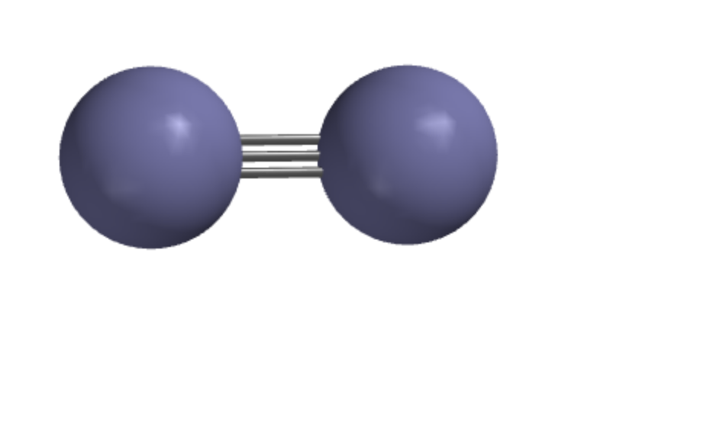
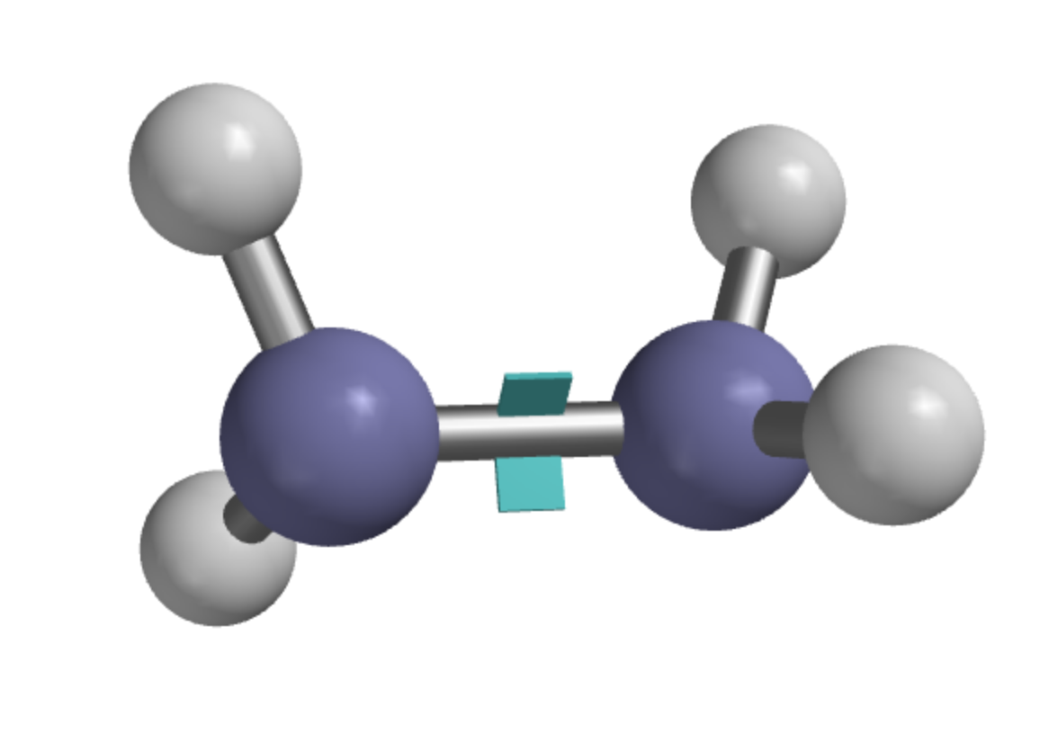
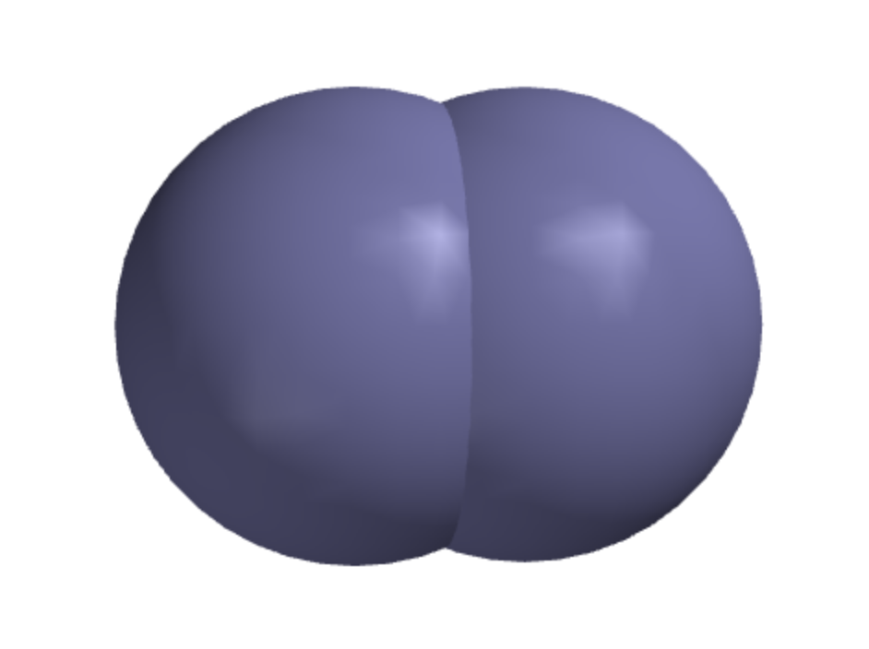
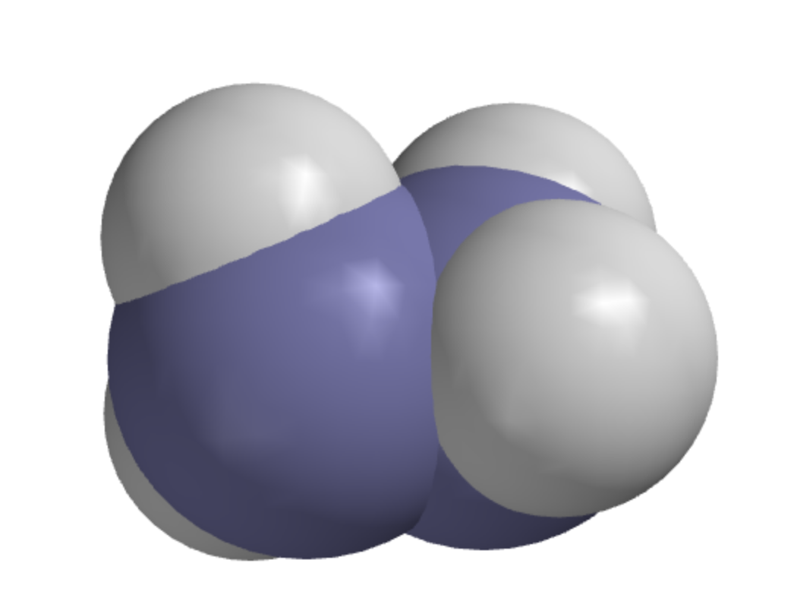
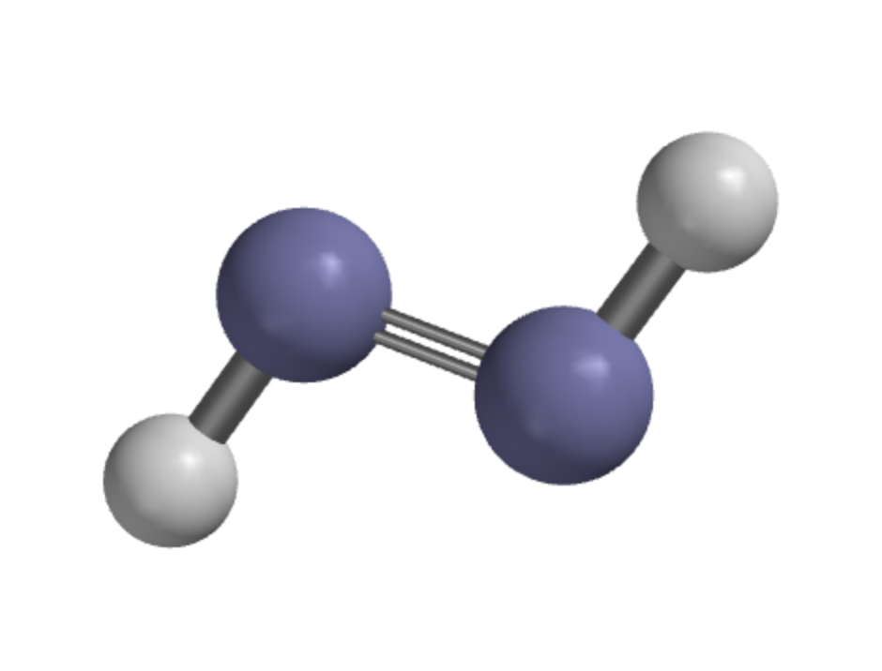
Structural Formulas of Nitrogen-containing molecules
H₄N₂ (Hydrazine)
H₂N₂ (Diimide)
N₂ (Nitrogen gas)

Slide 4
Reminder about the nomenclature: Bond Order
H₄N₂ (Hydrazine)
H₂N₂ (Diimide)
N₂ (Nitrogen gas)
Bond order between Nitrogen atoms is 1
Bond order between Nitrogen atoms is 2
Bond order between Nitrogen atoms is 3

Slide 5
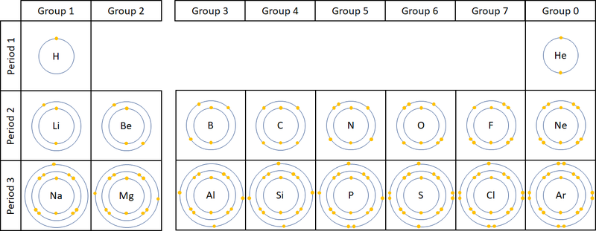
Valence shell electrons
We worry most about the electrons that are in the outermost shell, also called the valence shell. You should memorize the number of valence shell electrons in groups 4-7.

Slide 6
Making Lewis Structures from Structural Formulas
Add dots, in pairs if possible, around each atom until it has the total number of electrons in its valence shell. Each bond counts as two valence-shell electrons.

Slide 7
Making Lewis Structures from Structural Formulas
Add dots, in pairs if possible, around each atom until it has the total number of electrons in its valence shell (outermost shell).

Slide 8
Making Lewis Structures from Structural Formulas
Add dots, in pairs if possible, around each atom until it has the total number of electrons in its valence shell (outermost shell).

Slide 9
Making Lewis Structures from Structural Formulas
Add dots, in pairs if possible, around each atom until it has the total number of electrons in its valence shell (outermost shell).

Slide 10
Structural Formulas of Carbon-containing molecules
C₂H₆
C₂H₄
C₂H₂

Slide 11
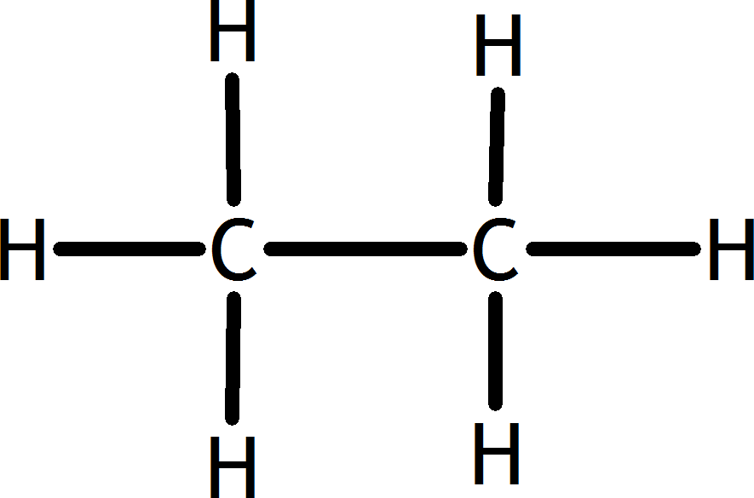
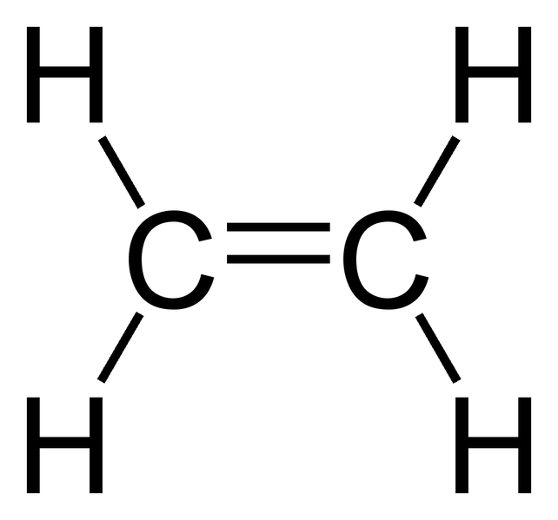
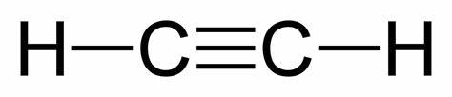
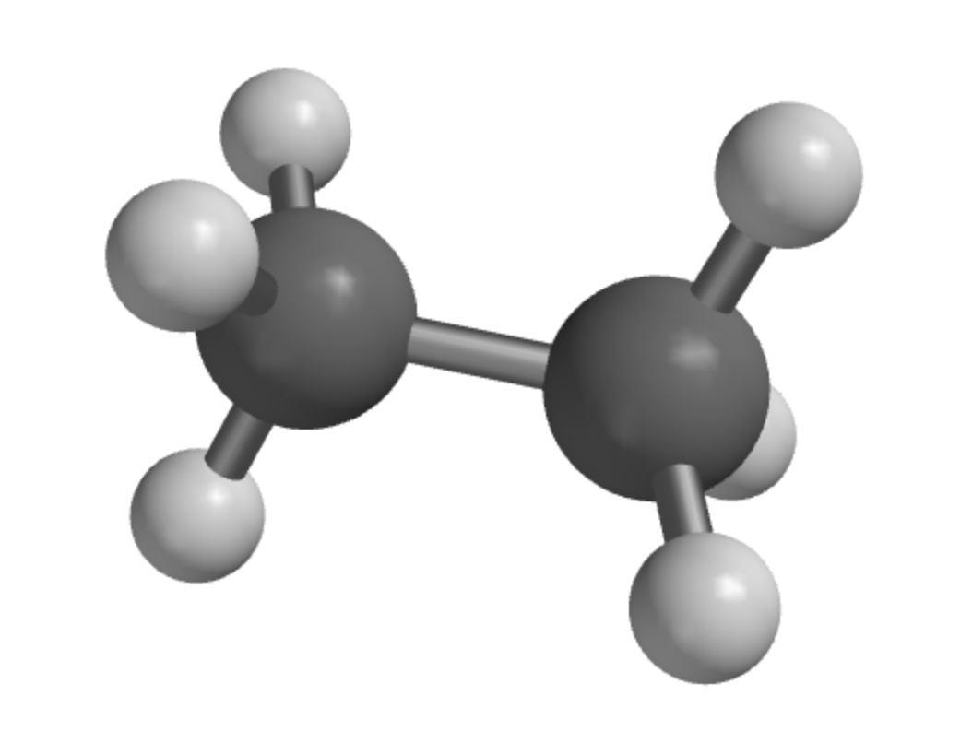
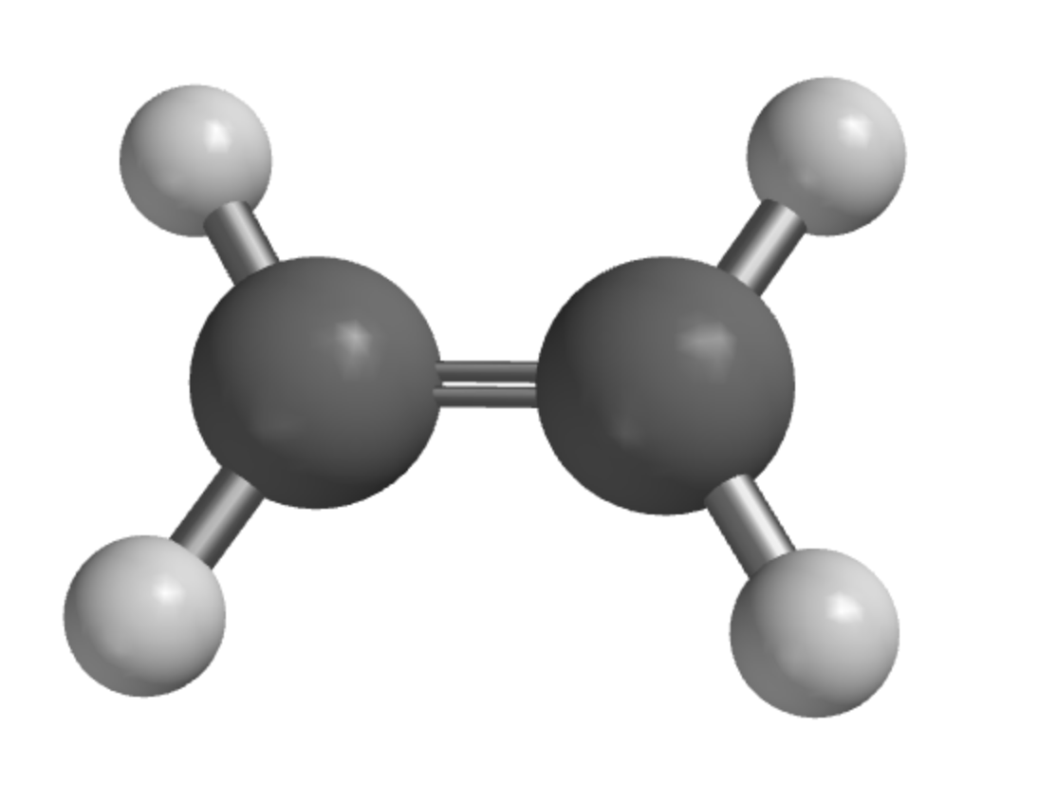
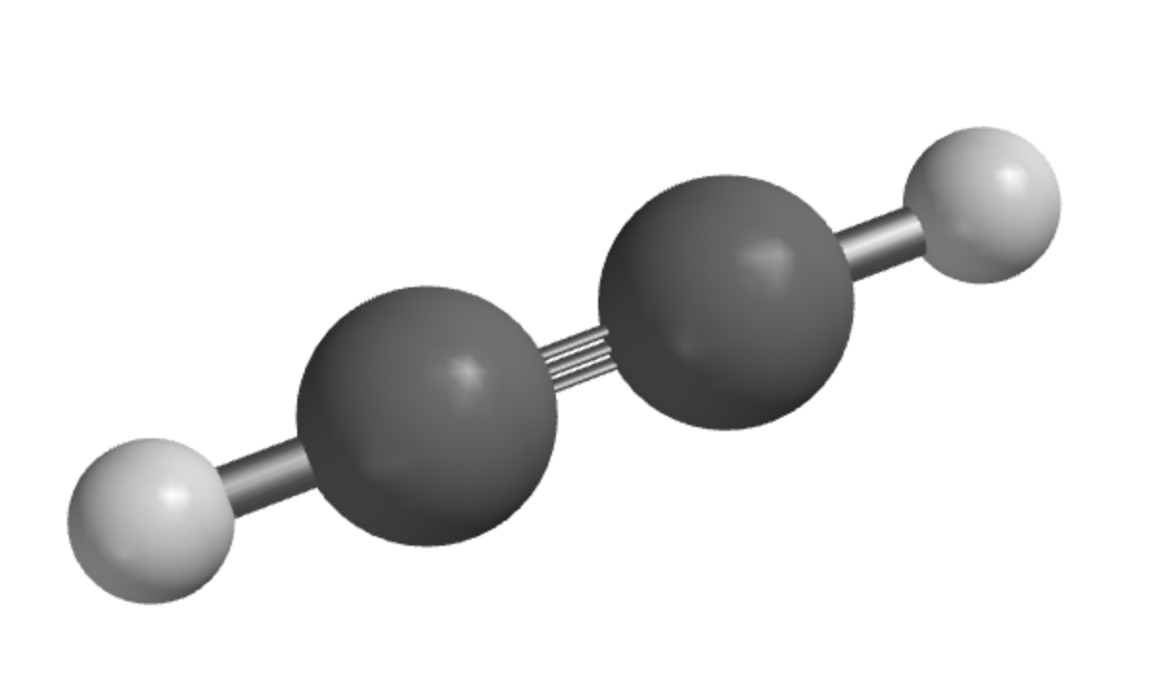
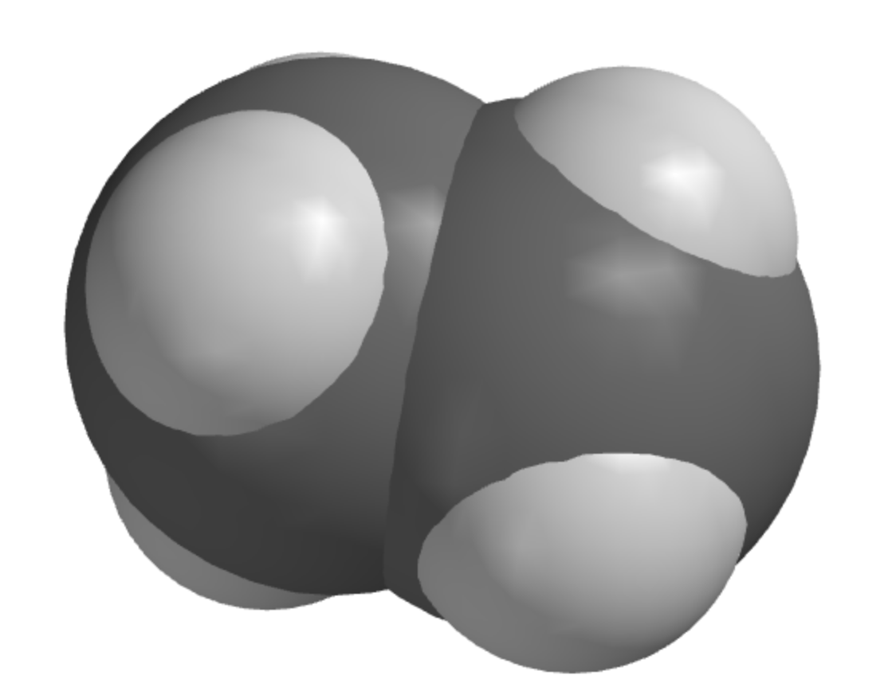
Structural Formulas of Carbon-containing molecules
C₂H₆ (Ethane)
C₂H₄ (Ethene)
C₂H₂ (Ethyne)

Slide 12
Making Lewis Structures from Structural Formulas

Slide 13
Making Lewis Structures from Structural Formulas
These Structural Formulas are also Lewis Structures because Carbon has four valence electrons

Slide 14
Structural Formulas of Oxygen-containing molecules
O₂
H₂O₂

Slide 15
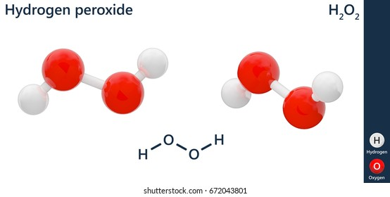

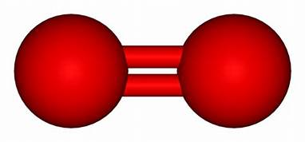
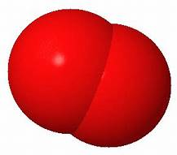
Structural Formulas of Oxygen-containing molecules
O₂
H₂O₂

Slide 16
Lewis Structures of Oxygen-containing molecules
O₂
H₂O₂

Slide 17
Correlation between bond order, bond strength, and bond length
Higher bond order (between carbon atoms)
Stronger C-C bonds
Shorter bond lengths
https://openstax.org/books/chemistry-atoms-first-2e/pages/9-4-strengths-of-ionic-and-covalent-bonds

Slide 18
Correlation between bond order, bond strength, and bond length
Higher bond order (between carbon atoms)
Stronger C-C bonds
Shorter bond lengths
Reasons for exploring this in Spartan
How much stronger?
How much shorter?
Practice at making Structural Formulas and Lewis Structures
https://openstax.org/books/chemistry-atoms-first-2e/pages/9-4-strengths-of-ionic-and-covalent-bonds

Slide 19
Correlation between bond order, bond strength, and bond length
Higher bond order (between carbon atoms)
Stronger C-C bonds
Shorter bond lengths
Challenges in exploring this in Spartan
How to build the molecules & fragments
Number of unpaired electrons in fragments
How to interpret the molecular energies to infer bond strengths
https://openstax.org/books/chemistry-atoms-first-2e/pages/9-4-strengths-of-ionic-and-covalent-bonds

Slide 20
Lewis Structures of fragments
Split down the middle

Slide 21
Lewis Structures of fragments
Split down the middle
One unpaired electron for each CH₃ fragment

Slide 22
Lewis Structures of fragments
Split down the middle

Slide 23
Lewis Structures of fragments
Split down the middle
Two unpaired electrons for each CH₂ fragment

Slide 24
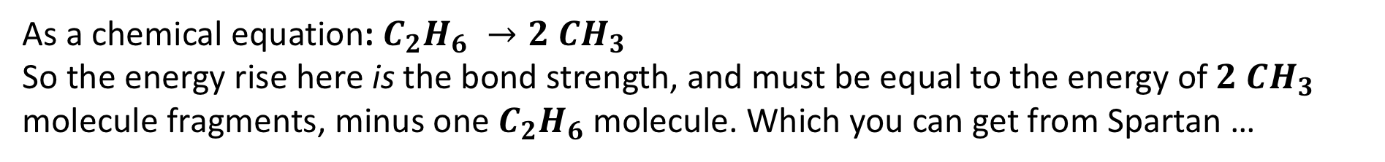


Bond Strength and Reaction Progress Diagrams
$${CH}_{3}+{ CH}_{3}$$
This diagram is called a Reaction Progress Diagram
Energy
$$C_{2}H_{6}$$
Reaction Progress
As a chemical equation: $C_{2}H_{6} →2 CH_{3}$
So the energy rise here is the bond strength, and must be equal to the energy of $2 CH_{3}$ molecule fragments, minus one $C_{2}H_{6}$ molecule. Which you can get from Spartan …

